Slide 1
NBAC TSC Slides 26 September 2024 Meeting

Slide 2
26 September 2024 NBAC TSC Agenda
1:00 NBAC Co-Chair Opening Remarks – Mr. Kamran Atri & Thomas Krul
Welcome: Analytical Laboratories prospective NIEMOpen Domain & Sub-Committee
Prospective Identity Management Domain & Sub-Committee
1:05 Analytical Laboratories Discussion
1:15 NIEM Management Office (NMO) Update – Ms. Katherine Escobar
NIEMOpen Reveal
New Sponsors
NIJ, BJS
Welcome back NAJIS
New prospective Sub-Committees
1:25 NTAC Update
1:30 Communications & Outreach NMO Sub-Committee update – Paul Wormeli
1:35 Community Updates - all
1:40 Questions/Final Remarks

Slide 3

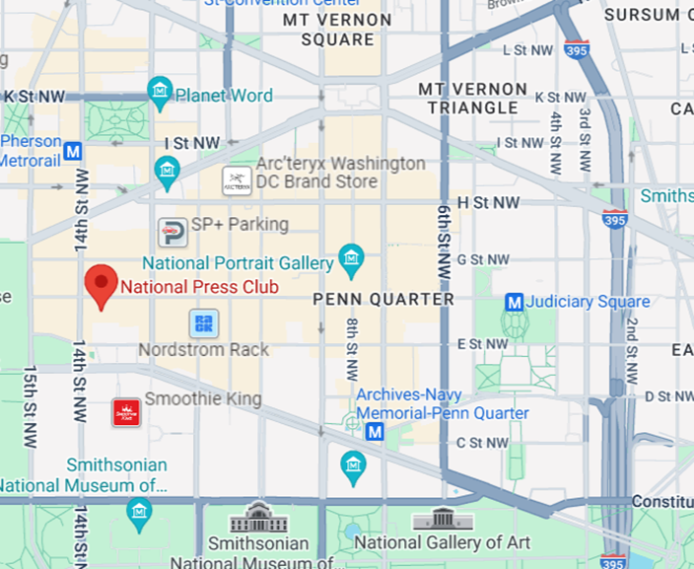
About the NIEM Reveal Training & Summit
A pivotal gathering driving advancements in information sharing and interoperability through immersive workshops, hands-on sessions, and insightful presentations.
Attendees gain a profound understanding of the latest NIEM architecture and are empowered to implement seamless, secure, and efficient information exchanges across organizational boundaries.
Tuesday, February 18 – Thursday, February 20
Washington D.C area (accessible to public transportation)
The National Press Club – 14th Street, NW
https://niemopen.org/reveal

Slide 4
Ways to learn more about the event and sponsorship opportunities
Visit the event website: https://niemopen.org/reveal
Download the sponsorship prospectus: https://niemopen.org/wp-content/uploads/2024/04/Summit-Sponsor-Info.pdf
Contact us directly: events@oasis-open.org

Slide 5








resources
Follow Us On Twitter
Katherine Escobar, katherine.b.escobar.civ@mail.mil, 7575-203-8631
Beth Smalley, beth.l.smalley.civ@mail.mil, 757-203-7177
Darcy Staley, darcy.a.staley.civ@mail.mil, 757-203-8711
Stephen Sullivan, stephen.m.sullivan14.ctr@mail.mil , 757-203-8619
https://twitter.com/NIEMconnects?ref_src=twsrc%5Etfw
https://www.niem.gov/
https://niemopen.org/
https://www.linkedin.com/groups/1903175/profile
Git Repos
NIEMOpen: https://github.com/niemopen/
NTAC TSC
https://github.com/niemopen/ntac-admin
NBAC TSC
https://github.com/niemopen/nbac-admin
NMO TSC
https://github.com/niemopen/nmo-admin
https://github.com/niemopen/nmo-training
NIEMOpen Slack Channel: https://niemopen.slack.com/
Mailing Lists
NIEMOpen: https://lists.oasis-open-projects.org/g/niemopen
PGB: https://lists.oasis-open-projects.org/g/niemopen-pgb
NTAC TSC: https://lists.oasis-open-projects.org/g/niemopen-ntactsc
NBAC TSC: https://lists.oasis-open-projects.org/g/niemopen-nbactsc
NMO TSC: https://lists.oasis-open-projects.org/g/niemopen-nmotsc
https://www.youtube.com/channel/UCg9qV22PXLBjG41hc-EwVrQ
MEP Registry & Repository
MEP Tool: https://mep.niemopen.org
CMFTool: https://github.com/niemopen/cmftool
NDR draft: “ndr6-outline.md” at https://github.com/niemopen/niem-naming-design-rules/blob/dev/ndr-v6.0-psd01.md
NIEMOpen Reveal Summit 18-20 Feb 2025

